Slide 1
Data Store Project

Slide 2
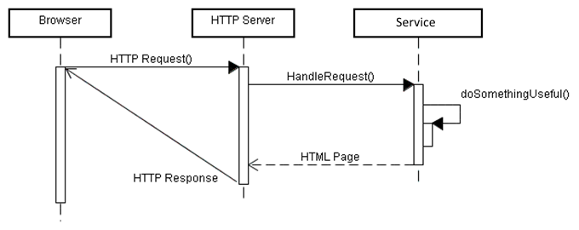
Client-Server Synchronous Messaging
Most network services are based on the synchronous, client-server interactions.
A service-providing server (HTTP server) that is accessible across the network.
Clients (Browsers) request a service from the server.

Slide 3
What Makes This Interaction Synchronous?
The Client and Server are synchronized.
Request processing is synchronous because the client halts waiting for the server to prepare and return its result.
There is a client and a server thread that must be coordinated or synchronized.

Slide 4
Client / Server interaction across a network is based on connections
Typical synchronous messaging follows these steps:
1. Client obtains the network address of the server.
2. Client creates a connection / socket to the server across the network.
3. Client sends a request message to the server and waits for a response.
4. The server processes the request, producing some information.
5. The server sends a response message containing the needed information back to the waiting client.
6. The client continues processing with the response information.
The client thread must block waiting for the response.

Slide 5
Clients connect to Servers installed at a specific network address and port number.
Network services are provided by servers installed at network addresses and ports.
TCP/IP (V4) addresses are four part e.g. 74.125.45.100
The address identifies a network-connected processor.
Each network address / processor can host multiple ports.
Ports are numbered 0-65,535.
So a processor can host many services / servers.
Servers “listens” for client connection requests.
A browser connects to an address and port
Typically, HTTP Web Servers are installed at port 80.
For example google.com is at: http://208.76.225.53:80/

Slide 6
Establishing the Server Process
Java provides the class ServerSocket.
ServerSocket listens for connection requests from clients.
ServerSocket.accept() blocks until a client requests a connection, and then establishes a new socket connection between the server and client processes.
ServerSocket serverSocket = new ServerSocket(10023);
Socket clientSocket = serverSocket.accept();
inputStream = clientSocket.getInputStream();
outputStream = clientSocket.getOutputStream();
// ... Read request from InputStream
// ... Write response to OutputStream
inputStream.close();

Slide 7
Establishing the Client’s Connection
Java provides the class Socket which accepts the IP address and port number of the listening service.
The service must be running / listening before the client request.
byte byteAddr[] = {127, 0, 0, 1}; // Server Address
InetAddress address = InetAddress.getByAddress(byteAddr);
SocketAddress saddr = new InetSocketAddress(address, 10023);
Socket socket = new Socket();
socket.connect(saddr); // Connects to server
InputStream inputStream = socket.getInputStream();
OutputStream outputStream = socket.getOutputStream();
// ... Write request to OutputStream
// ... Read response from InputStream
inputStream.close();

Slide 8
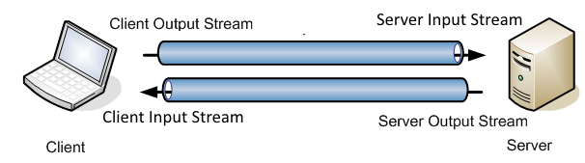
The socket allows data to be exchanged between client and server.
Each socket established two one-way byte steams between the client and server. Think of a stream as a Pipe (FIFO queue).
Each side’s output is the other side’s input stream
The client writes data to it’s output steam which is read by the server.
The server writes data to its output steam which is read by the client.
When the reader tries to read from its pipe when nothing has been written, the reader thread is blocked until data enters the pipe.
TCP/IP guarantees that data is delivered to the other end of the stream in the same order it was written.

Slide 9
Server Request Processing Loop
The server process repeats the process of
Accept Connection from Client
Read Request
Build and write Response
Close Connection
while (true) {
Socket clientSocket = serverSocket.accept();
inputStream = clientSocket.getInputStream();
outputStream = clientSocket.getOutputStream();
Handler handler = parseRequest(inputStream);
handler.run(inputStream, outputStream);
inputStream.close();
}

Slide 10
Building & Processing Messages
Sockets provide two pipes along which streams of bytes can be reliably exchanged between client and server processes.
The system (client & server) must agree upon the format of the request and response messages carried on those streams.
The request message contains the information needed by the server to understand what is being requested by the client.
The response message contains the information needed by the client.

Slide 11
Requesting a Service
Suppose the server is capable of providing multiple services.
The request message must first specify which services (operation) is requested by the client.
Following any additional information needed by the service to execute the operation.
The request message format might be:
operationName\n
argument1\n
argument2\n
Where the number of arguments depends on the requested operation.

Slide 12
Parsing the Message Format
From the previous example we saw that the client’s message…
Contains multiple sections i.e. operation ID and multiple arguments.
Has a method of separating one section from the other i.e. a delimiter or newline in the example (\n).
The server process receiving a message must be able to parse the sections from the byte stream.
The server must first determine which of several operations is being requested before it can parse the remaining message sections.
The client has it easy… It knows which request was sent so can anticipate the format of the response message.

Slide 13
Server Message Handling
The request message should contain the Operation ID in the message’s first section.
The server first reads the Operation ID and can determine how to parse the remainder of the request message.
On the next slide, the parseRequest() method…
Reads the first section of the message containing the Op ID.
Creates and returns the appropriate message handler.
The operation-specific handler ‘knows’ how to extract the remaining request sections / arguments.
And how to build the response needed by the client.

Slide 14
while (true) {
Socket clientSocket = serverSocket.accept();
...
Handler handler = parseRequest(inputStream);
handler.run(inputStream, outputStream);
...
}
Handler parseRequest(InputStream inputStream)
{
String commandString = inputStream.readLine();
if ("echo".equalsIgnoreCase(commandString)) {
Handler handler = new EchoHandler();
return handler;
}
else if ("reverse".equalsIgnoreCase(commandString)) {
Handler handler = new ReverseHandler();
return handler;
}
else {
// Handle unknown request error
}
}

Slide 15
Reverse Operation Handler Class
public class ReverseHandler
{
public void run(inputStream, outputStream)
{
// Read string to reverse from inputStream
String inMessage = inputStream.readLine();
// Write response on outputStream
String outMessage = reverse(inMessage) + "\n";
outputStream.write(“ok\n”);
outputStream.write(outMessage);
}
private String reverse(String data)
{
// Reverses string data and return.
return data.reverse();
}
}

Slide 16
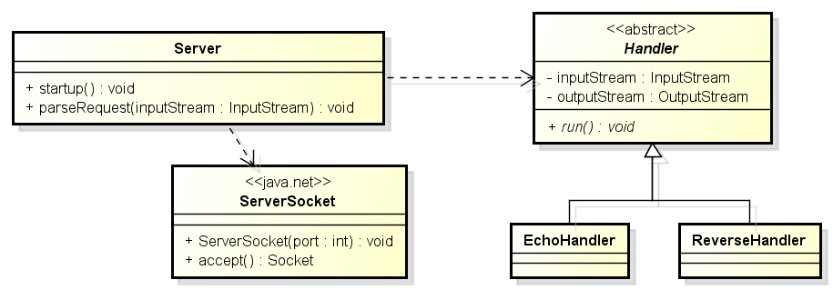
Design of the Sample Service
The sample code provided with the project gives the basic design of these server and message handling classes.

